Slide 1
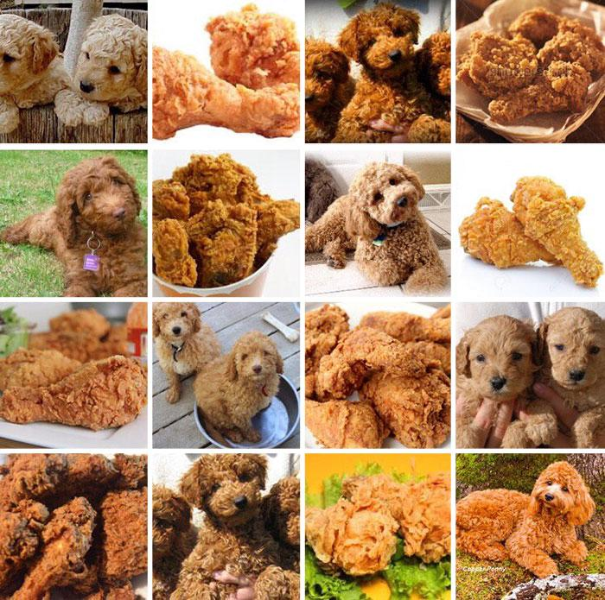
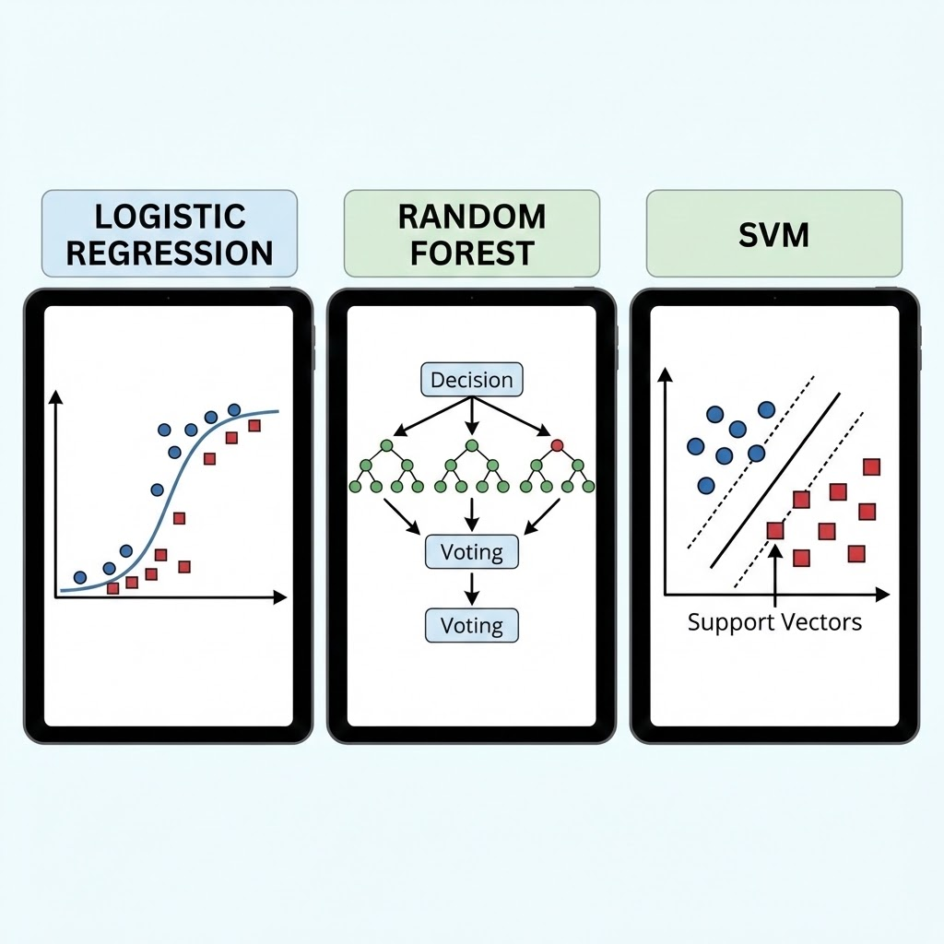
Comparison of Image Classification Methods

Slide 2
Overview of the Project
Data collection
Existing data sets from similar projects
web crawling + manuel out-sorting
Feature extraction
Training and model optimization
Model evaluation and Comparison

Slide 3
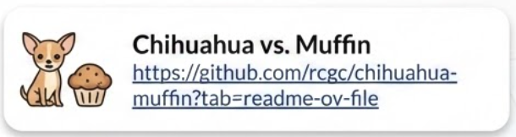
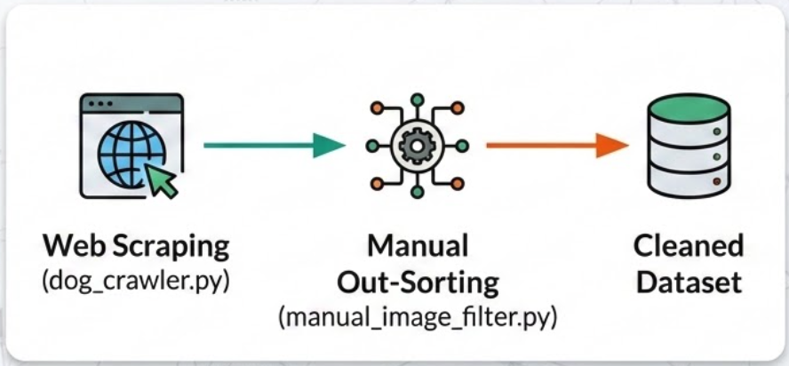
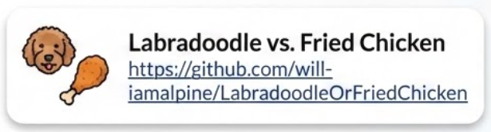
Data Collection
Existing Datasets
Puppy vs. Bagel dataset

Slide 4
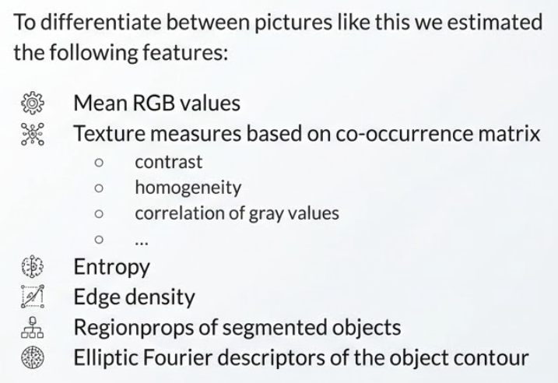
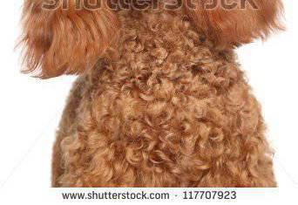
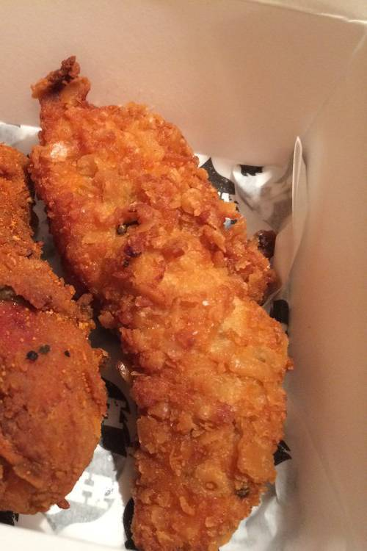
Feature Extraction (feature_extraction.py)

Slide 5
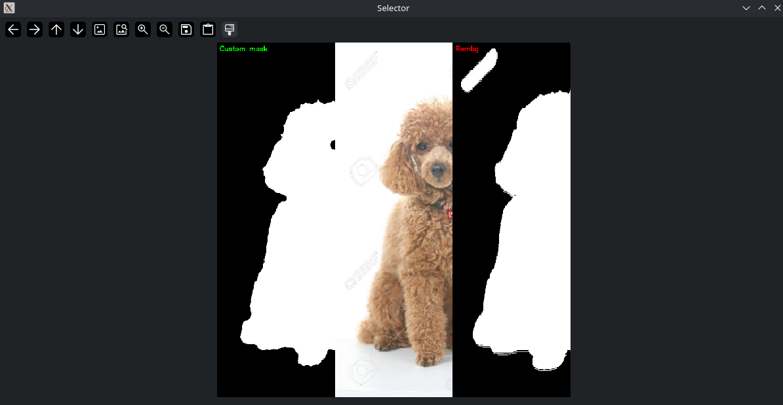
Manual Choosing of the better segmentation
For some of the image features a segmentation was required
Otsu thresholding often failed, used pre-trained segmentation model “Rembg” as well
For each image:
segment with Otsu + Rembg
visual comparison to choose the better one
Fallback Strategy
calculate feature on whole image
mark the image for the models

Slide 6
Model Training and evaluation
Each of the three models have been trained, optimised and evaluated on the same train, validate and test-datasets. The in depth analysis can be found in:
SVM/SVM.ipynb
trees/random-forest.ipynb

Slide 7
Model comparison: General performance measures
Model | Random Forest | SVM (rbf-kernel + optimised parameters)
Accuracy | 0.770 | 0.825
F1 | 0.770 | 0.81
AUC | 0.870 | 0.916

